Slide 1
711 Long John Rd Subdivision

Slide 2
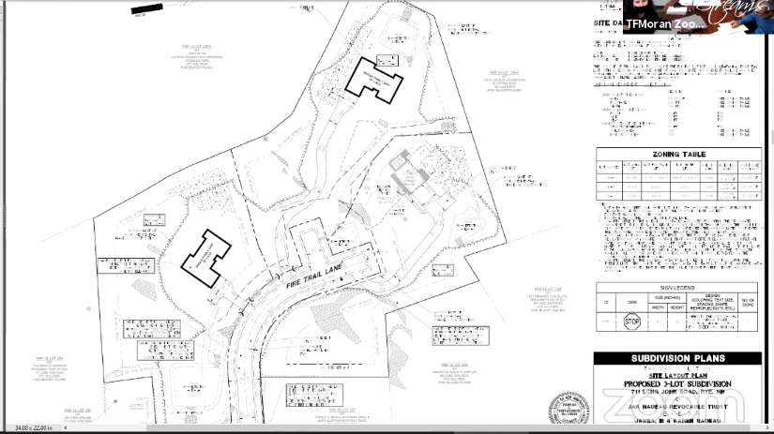

Slide 3
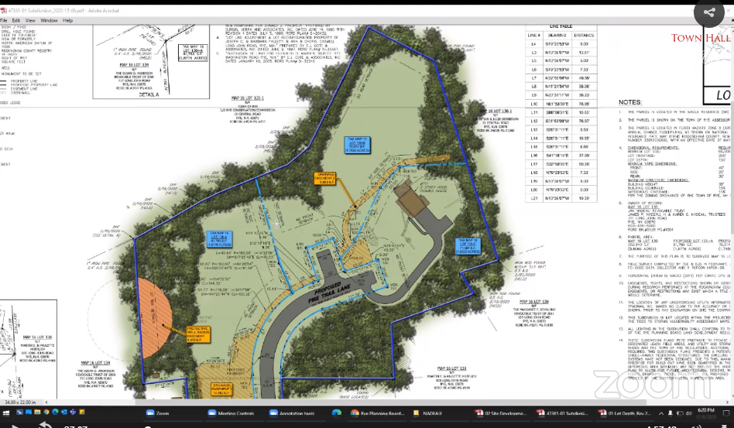

Slide 4
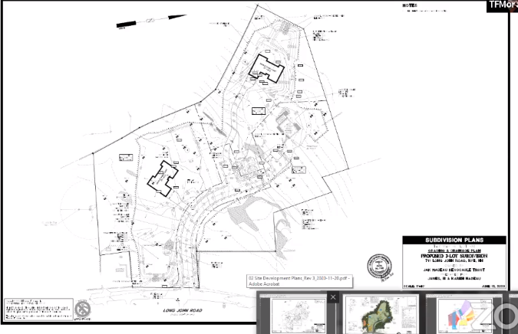

Slide 5
Wentworth by the Sea Country Club Patio and other expansions

Slide 6
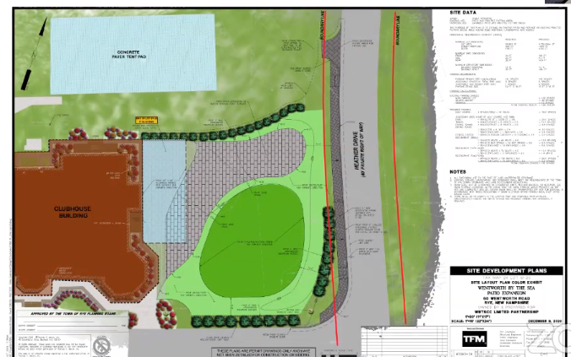

Slide 7
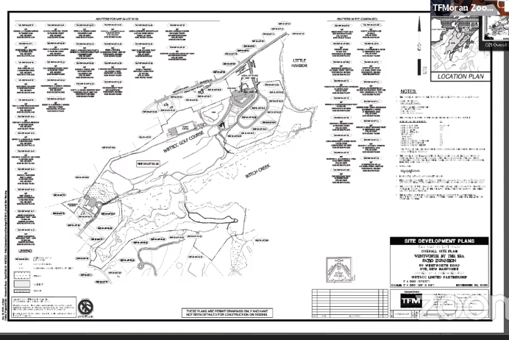

Slide 8
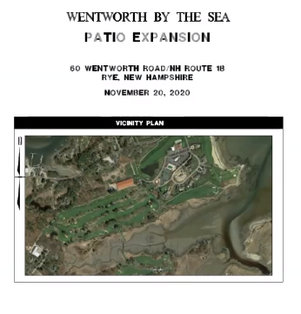

Slide 9
